Slide 1
USER-PERSONALISED MUSIC RECOMMENDATION SYSTEM USING COLLABORATIVE FILTERING
Done by :
Yuva Daranee P - 210420243063
Ashwin Kumar A - 210420243001
Sailesh V – 210420243061
Guided by : Amutha.S

Slide 2
Abstract
In this project we present a Personalised Music Recommendation System.
Even if the user is new, the login data is used to identify a similar user from the database and make recommendations that are relevant to that user.
Algorithms used:
Popularity based filtering
Item similarity based Collaborative Filtering
Singular Value Decomposition algorithm
User and song interaction matrix based on the number of listens to a song to offer a precise recommendation system.
Top 5 songs from each method are taken as per ranking to form a hybrid recommendation list thus providing a more accurate recommendation result
Our Dataset is Million Track Dataset released from Spotify that has been published and licensed to Kaggle for research purpose.

Slide 3
Introduction
Implicit recommendation generating mechanism, use the user information like age , gender etc. provided during login to create a hybrid recommendation of music for the new user.
Using those data we can classify similar users from the existing database to recommend the songs similar to them.
The new recommendation is based on 3 criteria,
Ranking songs based on listen counts and showing latest songs in the trend, we use Popularity based filtering.
Based on what you like in the past, and based on what other user have liked similar to you, we use Item similarity based Collaborative filtering.
Using listen count as a latent feature in a matrix Singular Value Decomposition algorithm is used to recommend user personalized music.

Slide 4
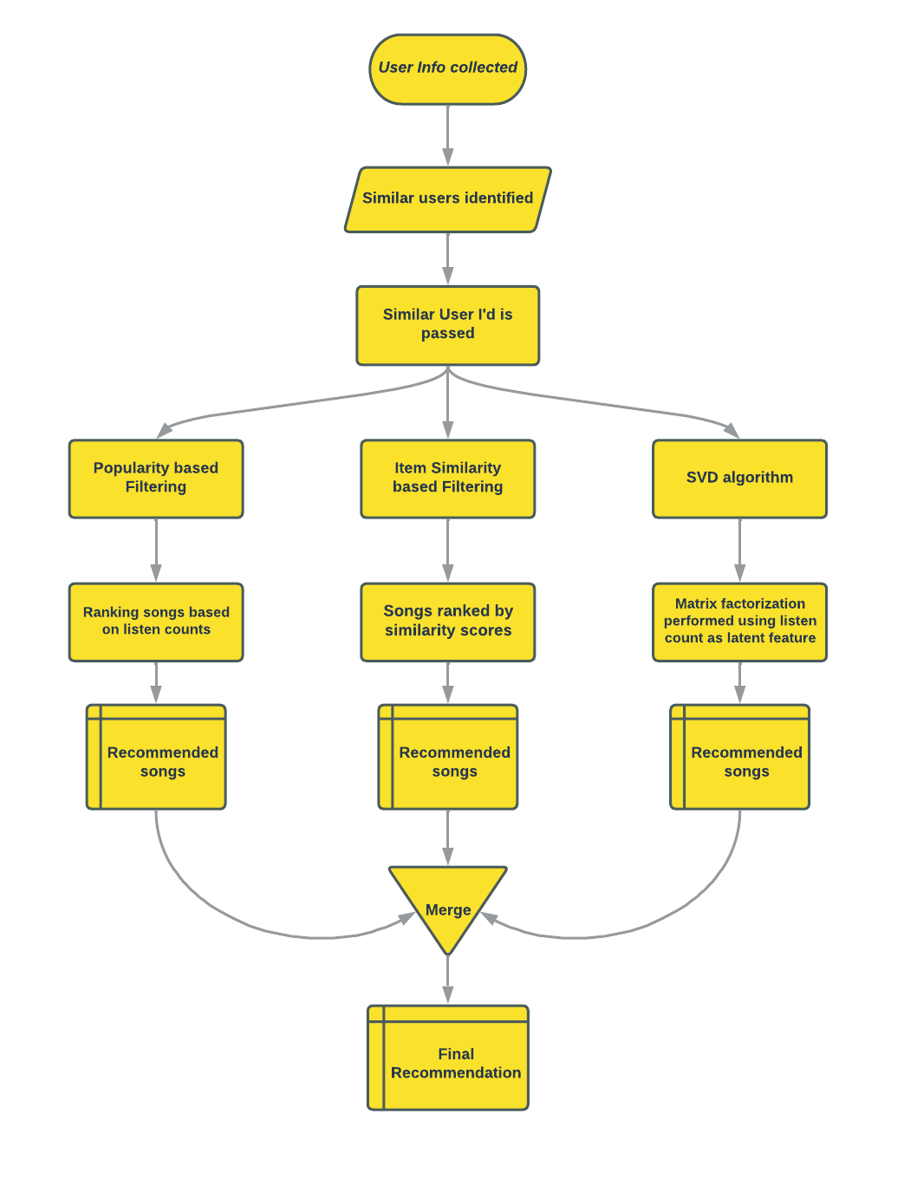
System Architecture

Slide 5
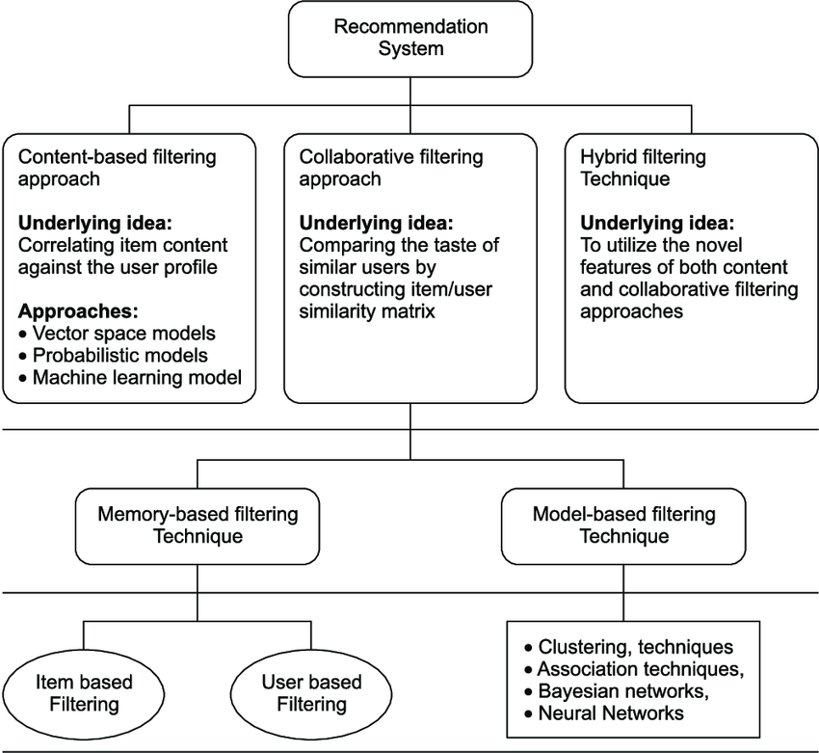
Recommendation Systems Overview

Slide 6
Literature Survey
- Existing System
[1]. Popularity Based Recommendation System
- Keshetti Sreekala
Abstract:
Objective :
To recommend the music for every user depending on the popularity at present.
Advantages:
Whatever is more popular among the general public that is more likely to be recommended to new customers.
Disadvantages :
This generalized recommendation is not personalized while recommending popular songs for the user.
International Journal of Engineering and Advanced Technology (IJEAT) ISSN: 2249 – 8958, Volume-9 Issue-3, February, 2020

Slide 7
Literature Survey
- Existing System
[2]. A Survey of Music Recommendation Systems and Future Perspectives
- Yading Song, Simon Dixon, and Marcus Pearce
Abstract:
Objective :
A bridge for the music recommender that should be able to lead the users reasonably choose music.
Advantages:
By considering aﬀective and social information, emotion-based model and context - based model largely improved the quality of recommendation.
Disadvantages :
Popularity bias - It recommends the popular music to the listeners which is not personalized.
Human effort- It is failed when the user failed to rate the songs since this algorithm uses only the rating feature
Cold start – Without having user preference it is failed to recommend for the new user.
9th International Symposium on Computer Music Modelling and Retrieval (CMMR 2012)
19-22 June 2012, Queen Mary University of London

Slide 8
Literature Survey
- Proposed System
[3]. How to build a simple song recommender system - Eric Le
Models Used : Popularity based Recommendation system
Objective: It applies a model which work based on listen count of the songs as a latent feature of recommendation, providing personalized recommendations.
Advantages : As a new user may tend to like popular songs, we use popularity based filtering to recommend for new users.
Source: https://towardsdatascience.com/how-to-build-a-simple-song-recommender-296fcbc8c85

Slide 9
Literature Survey
- Proposed System
[4]. Music Recommendation System Project using Python - Neelesh Biswas
Models Used : Item Similarity based filtering
Objective : It uses a model which use user’s listen count of the songs and number of unique songs for a given user to form a similarity score. Recommendations are provided to users based on that.
Advantages : It recommends songs personalized to a user’s music preference.
Source: https://www.codespeedy.com/music-recommendation-system-project-using-python/

Slide 10
Literature Survey
- Proposed System
[5]. Million Song - Recommendation Engines - Marcelo Marques
Models Used : Matrix Factorization method using SVD
Objective : To solve the implicit feedback problem using Singular Value Decomposition of song and user interaction matrix.
Advantages : It recommends songs personalized to a user’s music preference.
Source: https://www.kaggle.com/code/mgmarques/million-song-recommendation-engines

Slide 11
Literature Survey
References:
[1]. Popularity Based Recommendation System - Keshetti Sreekala https://www.researchgate.net/publication/355773477_Popularity_Based_Recommendation_System
[2]. A Survey of Music Recommendation Systems and Future Perspectives -Yading Song, Simon Dixon, and Marcus Pearce
https://www.researchgate.net/publication/277714802_A_Survey_of_Music_Recommendation_Systems_and_Future_Perspectives
[3]. How to build a simple song recommender system - Eric Le
https://towardsdatascience.com/how-to-build-a-simple-song-recommender-296fcbc8c85
[4]. Music Recommendation System Project using Python - Neelesh Biswas
https://www.codespeedy.com/music-recommendation-system-project-using-python/
[5]. Million Song - Recommendation Engines - Marcelo Marques
https://www.kaggle.com/code/mgmarques/million-song-recommendation-engines

Slide 12
Problem Statement
To provide more accurate and personalize music recommendations for new users by using data provided by user while login.
To recommend personalized music for users based on 2 algorithms which is proposed only for personalization.
To recommend without using ratings which is explicit data given by user, since the users are not always willing to rate.
To create a model that uses user’s information for the generation of recommendation.

Slide 13
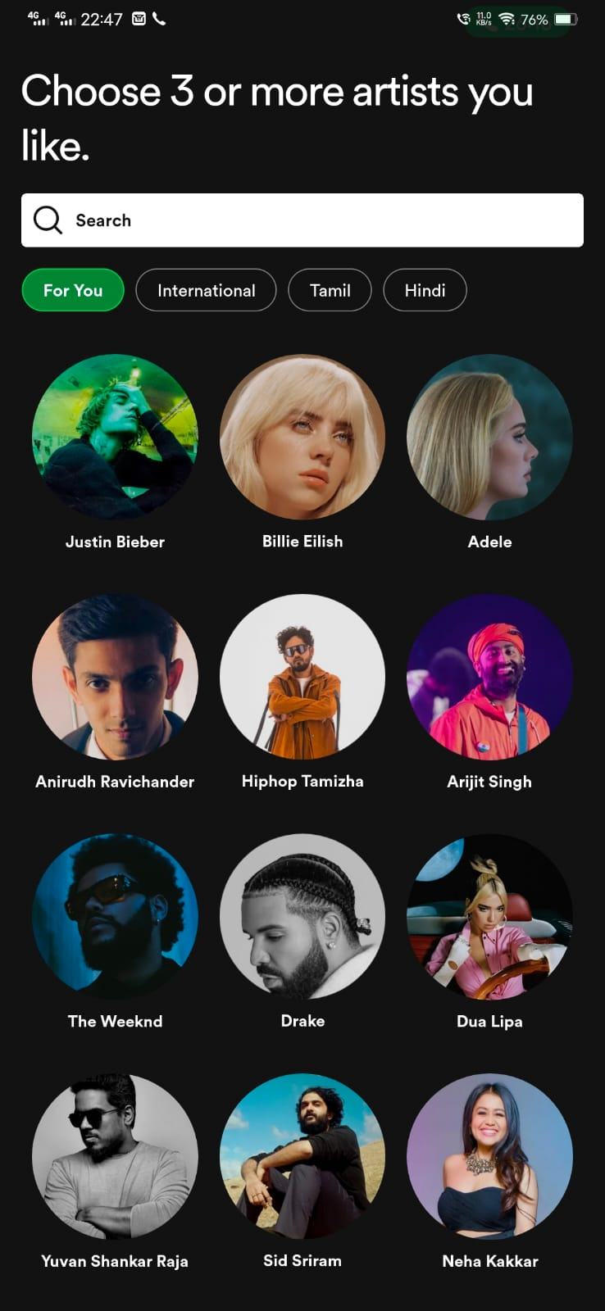


Existing system
Problems in the existing system:
The existing system of recommendation for new users work based only on popularity based engines from the user’s preferences on genre and artists.
It just recommends them the most popular songs of the genre and artist selected by the user based on popularity ranking.

Slide 14
Solution for existing problem :
Based on the user's data acquired in the application interface and other information provided by the user during login, identical users are recognized.
The program receives the user's similar user id and uses the songs listened to by the similar user for item-based recommendation to deliver comparable songs on a genre basis.

Slide 15
Proposed System
The proposed solution for the cold start problem is by recommending the new user a set of songs via a 3 basis system.
The user’s data is collected in the application interface and using that the other similar user is identified to recommend personalized music.
To recommend the songs in trend which covers the user’s preferences we use songs based on most listen count ranking.
To recommend the song suitable to the user, the songs listened by the similar user is used for item based recommendation to provide personalized songs.
To recommend songs based on the implicit rating, using the user and song relationship matrix, we use matrix factorization using SVD.
Finally we take the top 5 songs of every model used to provide a list of songs that covers the user’s preference by all means in an more accurate way.

Slide 16
Technology used
Domain : Music
Language : Python 3.10.8
Platform : Vs code
Techstack : (Packages used ):
Pandas – reading and accessing Database
NumPy – for calculations with arrays and matrices
Matplotlib.pyplot – for data visualization
Seaborn – to visualize random distributions
SciPy – for coo, csr, csc matrix generation and svds

Slide 17
System Requirements
Processor : i7 10th gen or above
Memory : 16Gb minimum
Storage : 5Gb of free space
Platform : VS code or Jupyter notebook

Slide 18
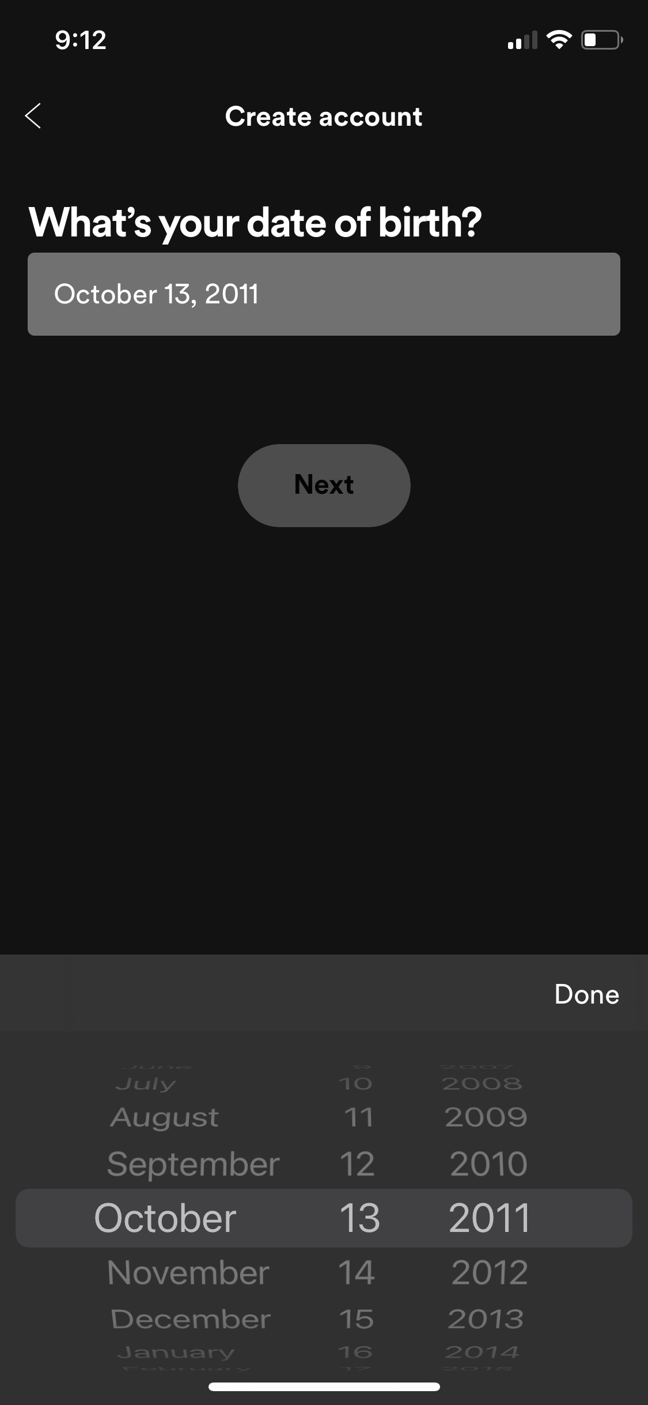
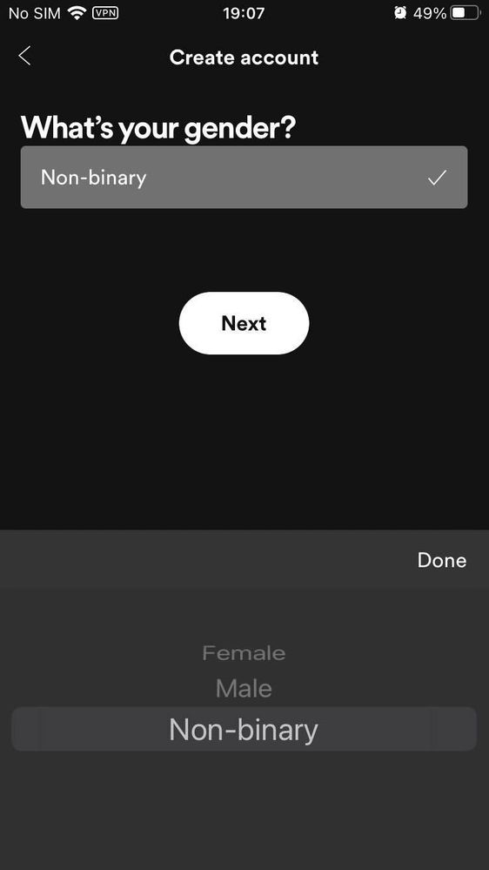
Spotify’s Login Interface
Spotify’s interface asking DOB and Gender to classify user, which can be later used for identifying a similar user from existing database
That similar user’s id can be passed into our program to receive recommendations based on various means for more accurate prediction.

Slide 19
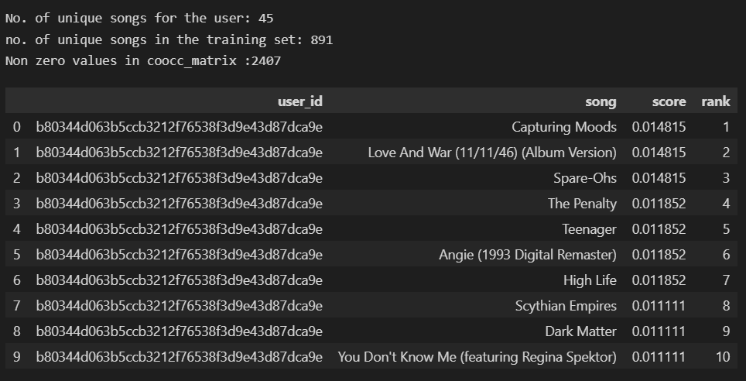
Program Output
Songs recommended by Item similarity based Recommendation system for passed in user-id

Slide 20
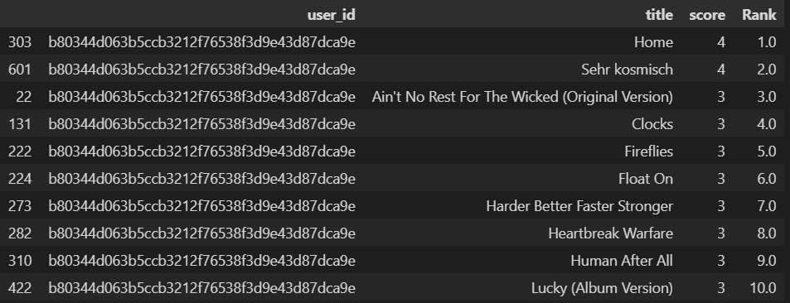
Program Output
Songs recommended by Popularity based Recommendation system for passed in user-id

Slide 21
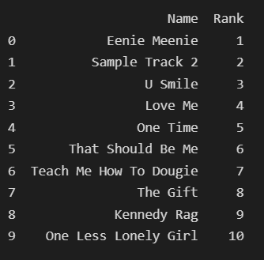
Program Output
Songs recommended by Collaborative system using SVD for passed in user-id

Slide 22
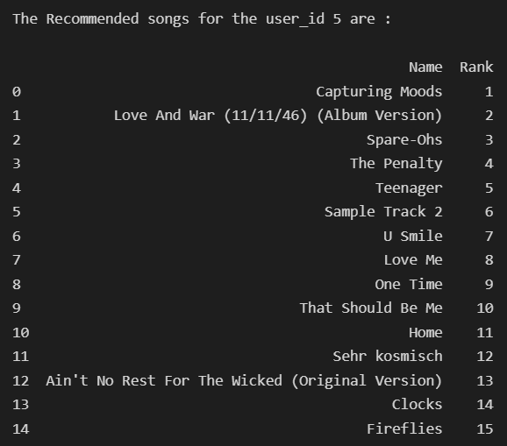
Program Output
Final song recommendations from best songs of each model

Slide 23
Conclusion
In this paper we explain a popularity based filtering model and two collaborative filtering models.
Models when considered individually consist of drawbacks like popularity bias and human effort, not personalized.
Moreover the use of hybrid of these models outperforms a single model as it incorporates the advantages of both methods.
Recommendations are made based on best five songs from each of the models.
So it is made to fit in the user’s preference in more than one criteria.

